Slide 1
Pose Estimation
Nischal K N

Slide 2
Two Methods
Point to Point
Point to Plane

Slide 3
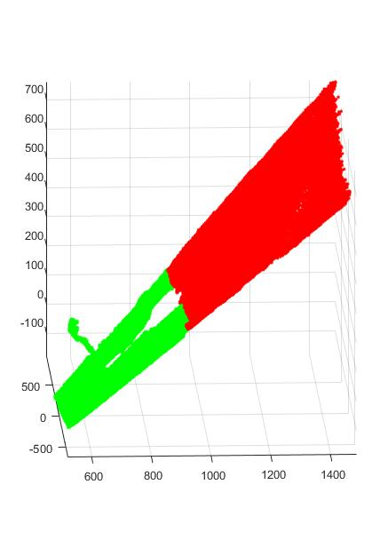
Ground removal
Threshold the depth

Slide 4
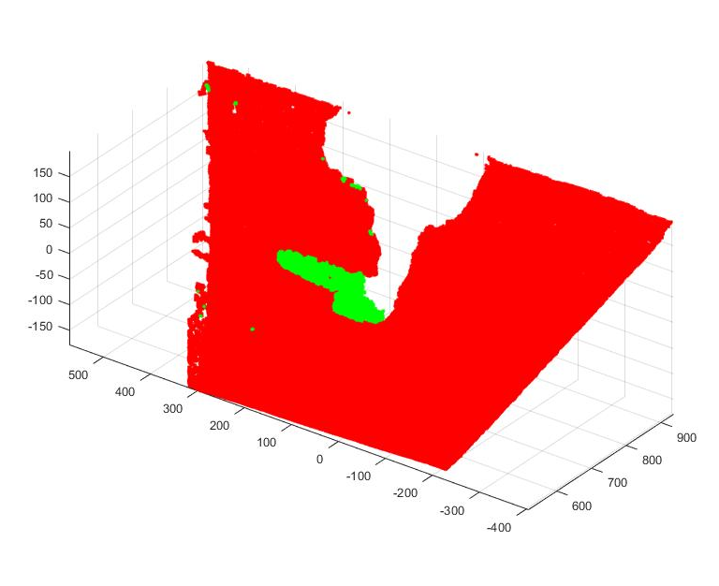
Ground removal
Threshold the depth
Perform RANSAC

Slide 5
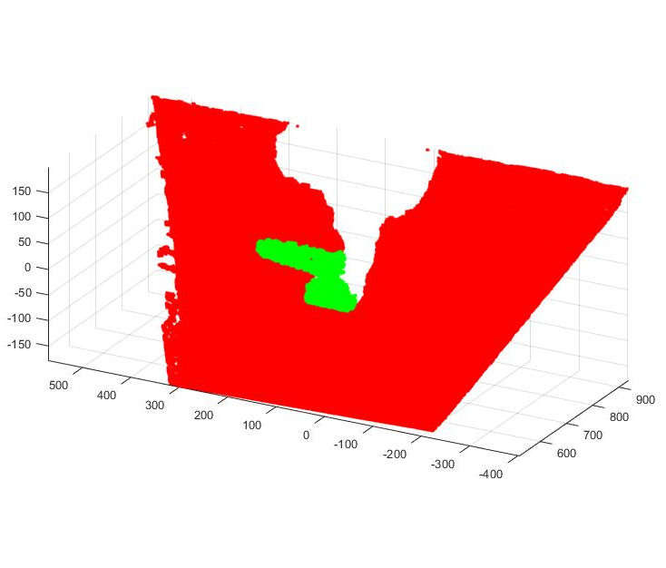
Ground removal
Threshold the depth
Perform RANSAC
Filter stray pixels

Slide 6
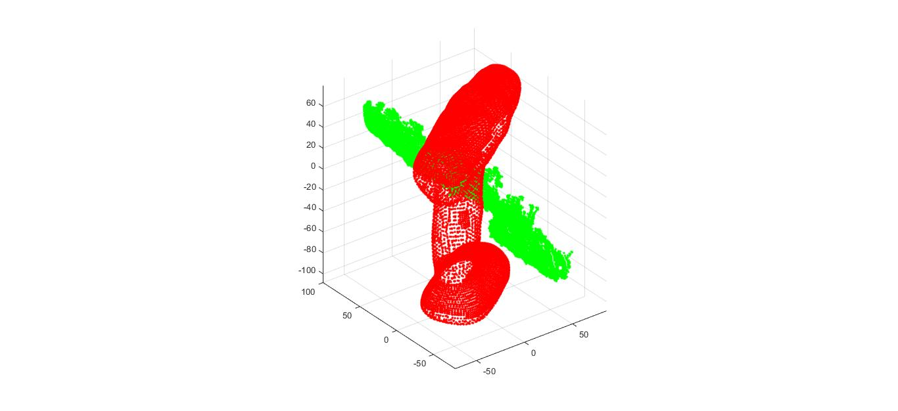
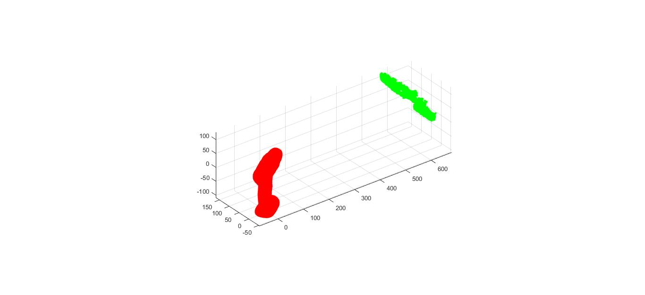
Initializing ICP
Without mean centering
Mean centering

Slide 7
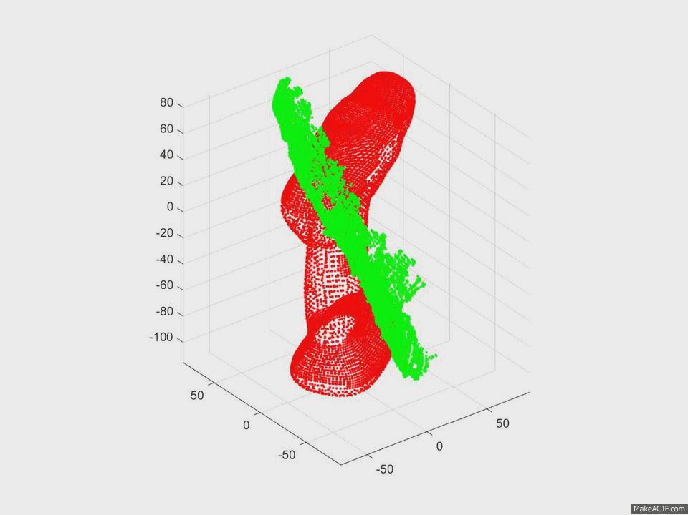
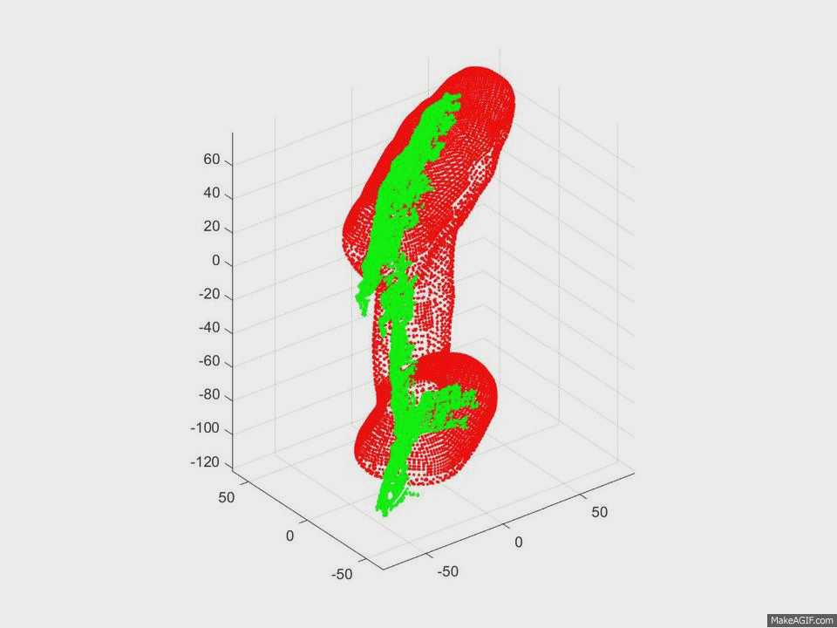
ICP – Drill
Point to Point
Point to plane
Iterations: 49, Time Elapsed: 8.3335s
Iterations: 10, Time Elapsed: 2.2156s

Slide 8
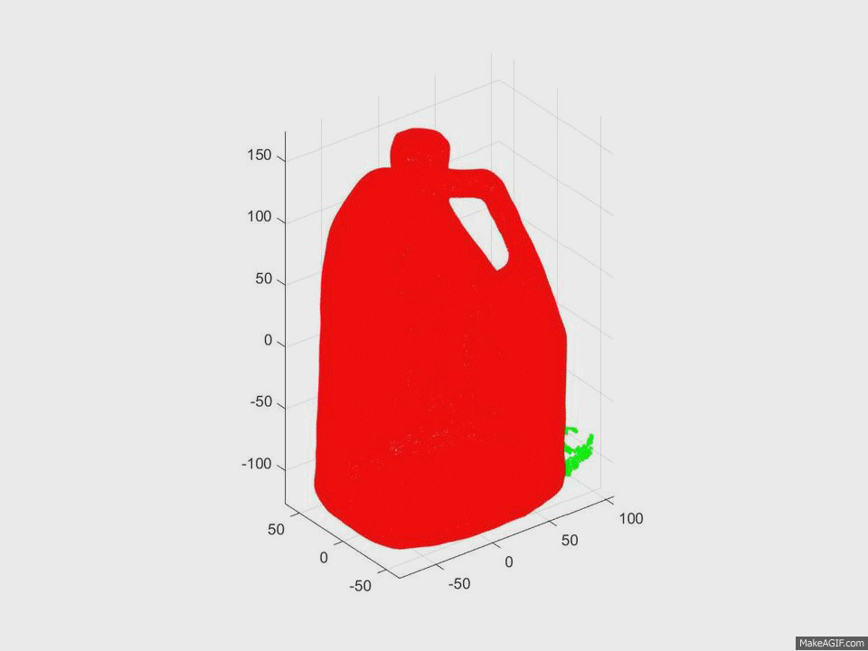
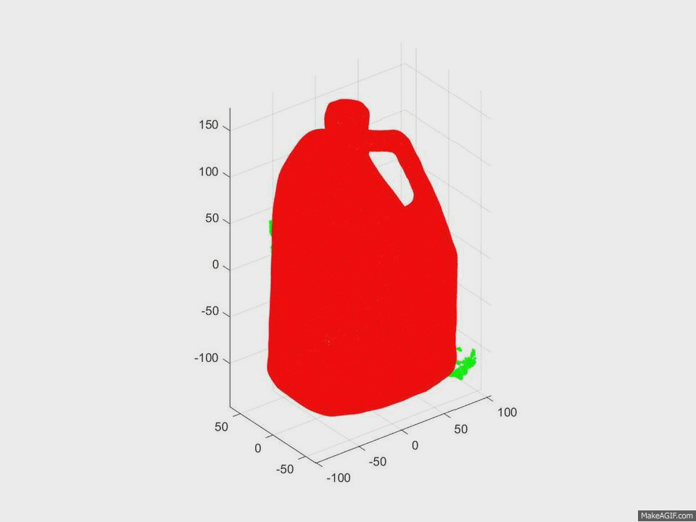
ICP - Container
Point to Point
Point to plane
Iterations: 81, Time Elapsed: 49.1506s
Iterations: 16, Time Elapsed: 7.0717s

Slide 9
Next step
Camera Pose estimation
GoICP

